Slide 1
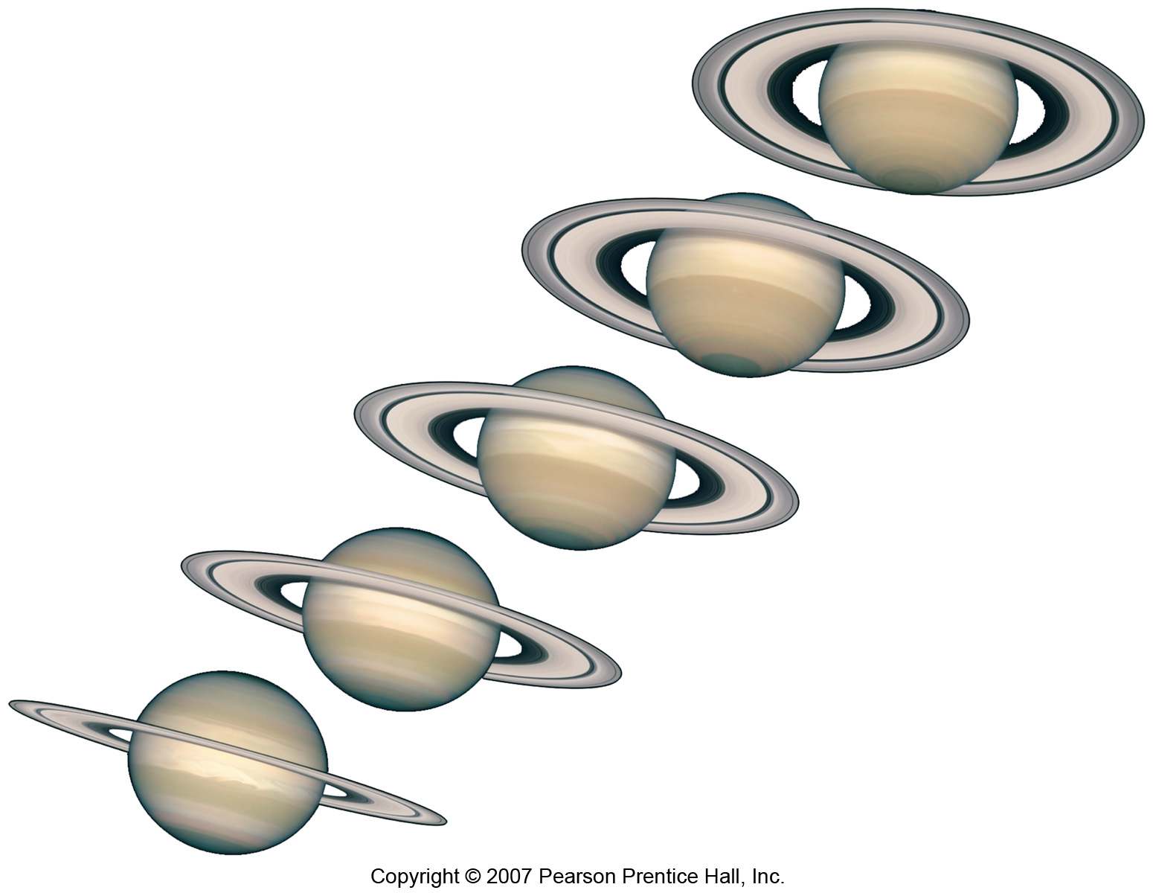
Gravitation & Satellite Motion

Slide 2
Questions about gravity
What is the difference between weight and mass?
What would you weigh at the North Pole?
How much would you weigh at the centre of the Earth?
What is gravitational acceleration at the Earth’s surface?
What is gravitational acceleration in ‘space’ (say at a height of a space shuttle orbit?)
How far away do you have to go to escape Earth’s gravity?
Why are satellites orbiting the Earth said to be in ‘free fall’?
Does the Moon orbit the Earth? Does the Earth orbit the Moon?

Slide 3

Apparent Weight
We are aware that weight is a force, caused by the action of gravity upon our mass.
However, ‘weight force’ is not what causes us to feel the sensation of weight – that is caused by reaction forces.
The weight force acts through us onto a surface. The reaction force/normal force acts through the surface onto us – this allows us to experience our own weight. However, it is quite possible to change this reaction force and thus change how we experience weight; we can make ourselves feel heavier, lighter, or even weightless.
Notes:
Start

Slide 4
Apparent Weight
To understand this, we need to consider an elevator that is accelerating down, accelerating up, or moving at a constant velocity.
Let us start with an elevator staying still.
In this case, the forces acting on us will be the same as if we were weighing ourselves in our actual bathroom. The weight force and the reaction force would be equal but opposite, making the net force 0.
We can write this out as an equation:
F_{Net} = F_{W} + F_{N}
Rearranging to solve for normal force, we get:
F_{Net} - F_{W} = F_{N}
If the net force is 0, we get:
- F_{W} = F_{N}
This demonstrates that, as we expected, if the net force is 0 then the weight force and normal force are equal yet opposite (hence the negative).
Notes:
Start

Slide 5
Apparent Weight
Of course, a net force of 0 does not only occur when the elevator is standing still – it occurs for any situation where the elevator is not accelerating. Therefore, the reading that we get from the scales in an elevator that is stationary, and the reading that we get from the scales in an elevator moving at a constant velocity (i.e. not accelerating) are identical.
Notes:
Start

Slide 6
Apparent Weight
Now let us consider an elevator accelerating down, and begin by drawing in the forces we know…
We know weight force.
We know net force (direction of elevator acceleration).
The net force, as before, is going to be the vector sum of the weight force and the reaction/normal force i.e.
F_{Net} = F_{W} + F_{N}
However, since we know where the weight force and net force are, it makes sense to draw these in first, then work out where the normal force goes. Again, we can rearrange the first equation to find the magnitude of the normal force (as before).
F_{Net} - F_{W} = F_{N}
The normal force, and therefore our apparent weight, is much smaller than the weight force i.e. we feel lighter than usual.
Notes:
Start

Slide 7
Apparent Weight
Given this equation, we realise that if the net force and the weight force are equal, then the normal force is 0. This occurs when we are in freefall, and under such conditions we would experience weightlessness.
F_{Net} - F_{W} = F_{N}
If this isn’t immediately apparent to you, conduct the following thought experiment – imagine that you are standing on a set of bathroom scales in an elevator that is accelerating downwards in freefall (see diagram).
If you are falling at 9.8 m/s², and the scales/elevator are also falling at 9.8 m/s², then what force are you exerting on the scales? What reading will the scales display, and does this make sense with reference to the equation above?
Now, what if you are accelerating downward at 9.8 m/s², but the elevator/scales is accelerating downward at 8.8 m/s² ? Now you are accelerating into the scales faster than they can accelerate away from you. Does your reading increase, decrease or stay the same as your freefall scenario? How does it compare to your normal reading when the elevator is not moving?
Notes:
Start

Slide 8
Apparent Weight
You should have realised that the reaction/normal force (or ‘apparent weight’) should have decreased from what you would experience in a stationary elevator i.e. we would feel lighter than usual. For an elevator accelerating upwards, then, we would perhaps expect the opposite i.e. we would expect to feel heavier than usual. Let’s find out.
Using the same equations, we can consider an elevator accelerating upwards.
F_{Net} = F_{W} + F_{N}
∴
F_{Net} - F_{W} = F_{N}
Draw in weight force.
Draw in net force.
Use equation(s) to determine where to draw normal force.
As we can see, the normal force is far bigger than the weight force… our apparent weight, therefore, has increased, just as predicted.
Notes:
Start

Slide 9
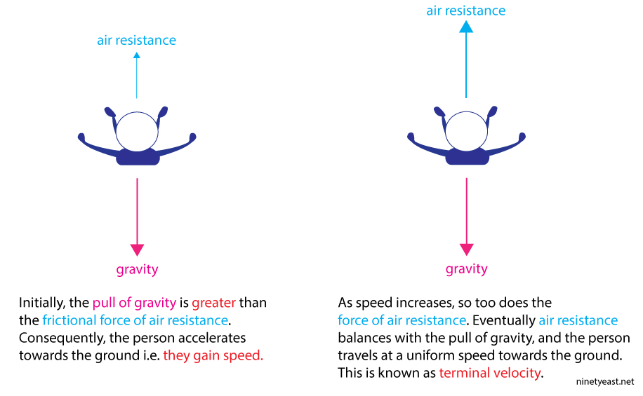
Terminal Velocity
Notes:
Start

Slide 10
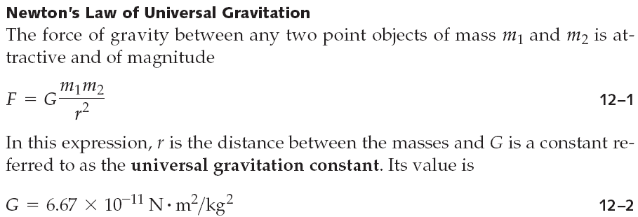
Newton’s Law of Universal Gravitation
Newton’s insight:
The force accelerating an apple downward is the same force that keeps the Moon in its orbit.
Hence, Universal Gravitation.
Notes:
Start

Slide 11
Newton’s Law of Universal Gravitation
How far do you need to go to escape Earth’s gravity?
Well, the equation shows us that the force of gravity drops off pretty quickly due to the inverse-square relationship. However, to truly escape the pull of gravity (of any mass), r→∞ in order for F→0.
Notes:
Start

Slide 12
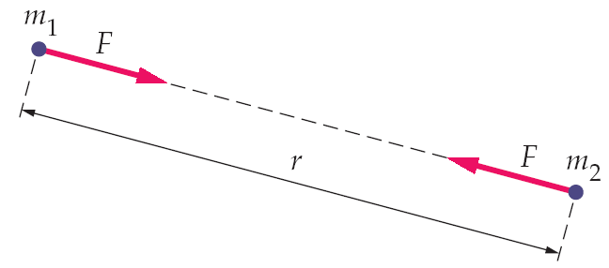
Newton’s Law of Universal Gravitation
The gravitational force is always attractive, and points along the line connecting the two masses:
The two forces shown are an action-reaction pair.

Slide 13
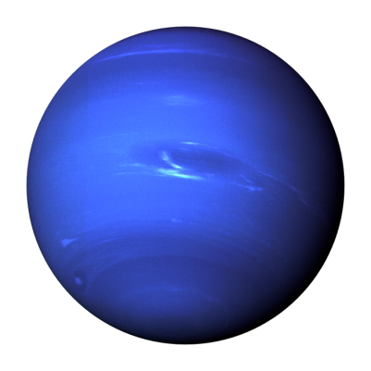
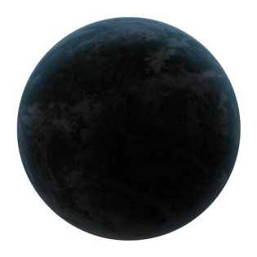
Gravitational Attraction of Spherical Bodies
Gravitational force between a point mass and a sphere: the force is the same as if all the mass of the sphere were concentrated at its center.
As long as we are calculating forces outside the sphere
What happens inside the sphere?

Slide 14

Inside the Sphere
The equation predicts that the gravitational force will go to ∞ .
However, the mass of the planet is (roughly) evenly distributed around you, so the forces actually cancel out to 0.

Slide 15
At the Poles vs. At the Equator
The Earth is not perfectly spherical – it is an oblate spheroid (a slightly squashed sphere). This means that the poles are slightly closer to the center of the Earth than the equator. According to our equation (and empirical measurements), this means that we are heavier at the poles than we are at the equator.
r
R
R > r

Slide 16
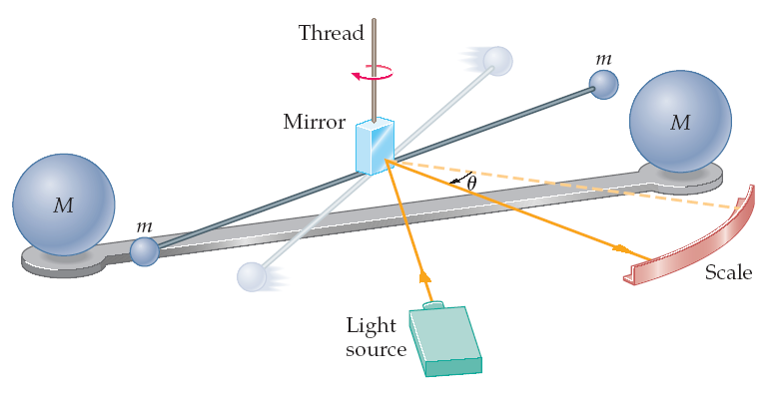
Cavendish experiment – Finding ‘G’ (not ‘g’)
Cavendish set up small spherical masses on a thread attached to a mirror (torsion balance):
Even though the gravitational force is very small, the mirror allows measurement of tiny deflections.

Slide 17
Cavendish experiment
Cavendish measured the gravitational force between the metal masses, which then led to a value for the gravitational constant, G.
Measuring G also allowed the mass of the Earth to be calculated, as the local acceleration of gravity and the radius of the Earth were known.

Slide 18
Gravity fields
Gravity is a non-contact force
Like all non-contact forces, we picture it as acting over a ‘force field’ extending out of the body and causing the force
This is one way of picturing a force field – the number of arrows is proportional to the strength of the force
M

Slide 19
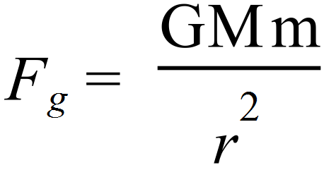
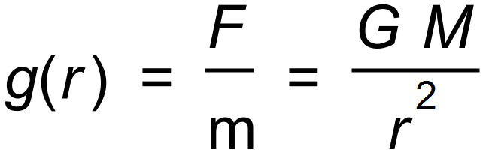
Idea of Test Mass
Notice that the actual amount of force depends on the mass, m:
To compare strengths of fields, we consider the force per unit mass. The idea is to imagine putting a unit test mass (i.e. 1 kg) near the Earth, and observe the effect on it:
g(r) is the “gravitational field strength.”
m
M

Slide 20
Concept of a Test Mass
g is also the symbol used for gravitational acceleration
This is because they are equivalent quantities
Units of field strength are:
N / kg
Units of gravitational acceleration are:
m / s²
Equivalent units

Slide 21
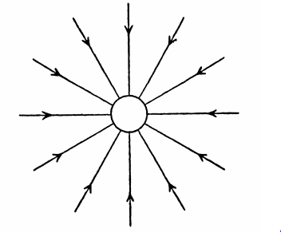
Gravity fields
Rules for drawing field lines:
Lines point towards the mass causing the field (lines show direction of travel for ‘test mass’).
Lines do not overlap.
Lines touch surface at right angles.
For stronger fields, lines are closer together. For weaker fields, they’re further apart.

Slide 22
Newton’s Law of Universal Gravitation
G is a very small number; this means that the force of gravity is negligible unless there is a very large mass involved (such as the Earth).
If an object is being acted upon by several different gravitational forces, the net force on it is the vector sum of the individual forces.
This is called the principle of superposition.

Slide 23



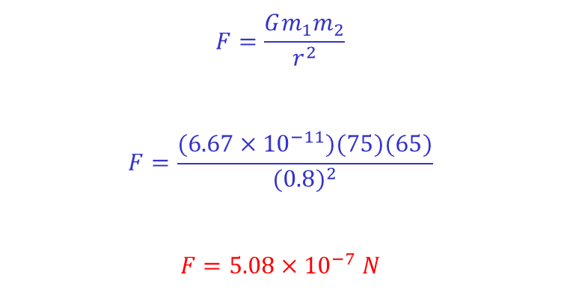
Force of Attraction Between 2 People
0.8 m
m₁ = 75 kg
m₂ = 65 kg
$$F=\frac{Gm_{1}m_{2}}{r^{2}}$$
$$F=\frac{(6.67×{10}^{−11})(75)(65)}{{(0.8)}^{2}}$$
$$F=5.08×{10}^{−7} N$$
*This force is really small – such that the force of static friction between your feet and the ground is more than enough to overcome it. This is why you do not drift towards the person sitting next to you… so no, you can’t use gravity as an excuse for snuggling up to someone!

Slide 24
Force of Attraction Between 3 People
If we were asked to find the net force of gravitational attraction acting on the girl as a result of the 2 boys, we would calculate the magnitude of each force separately and then add them to find the vector sum (obviously, we would need to know the direction of each force also).

Slide 25
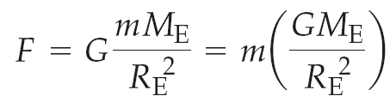
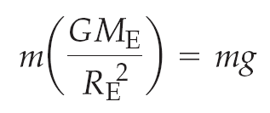
Gravitational Attraction of Spherical Bodies
What about the gravitational force on objects at the surface of the Earth? The center of the Earth is one Earth radius away, so this is the distance we use:
Therefore,

Slide 27
General Gravitational Acceleration

Slide 28
Field strength vs acceleration Recall N/kg and m/s² are equivalent units
However, although the acceleration due to gravity must be quoted in m/s², if you are asked for gravitational field strength, you should quote it in N/kg
E.g. a) What is the gravitational field strength due to the Earth (only) at a distance of one lunar orbit from the Earth?
b) What is the local acceleration due to Earth’s gravity?
a) M_{E} = 5.98 x 10²⁴ kg
Mean Earth-Moon distance r = 3.84 x 10⁸ m
b) a = 2.70 ×10⁻³ m s⁻²

Slide 29
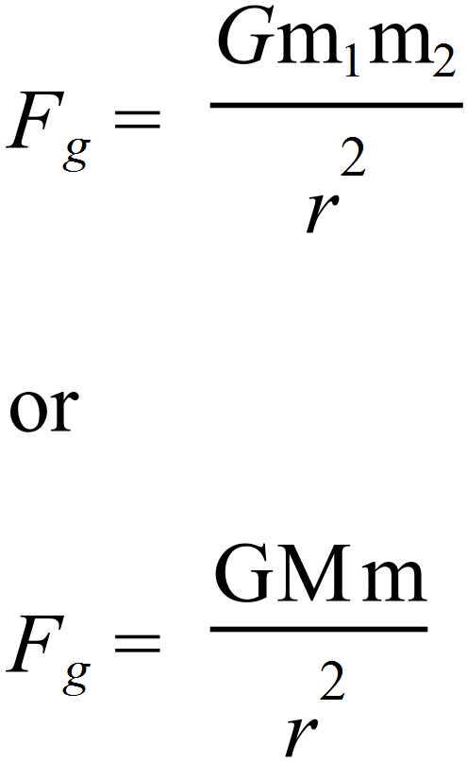
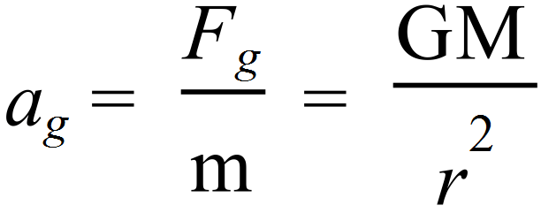
Again

Slide 30
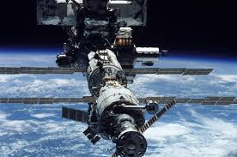
Practice Q 1
LEO = Low Earth Orbit (altitude = 160-2000 km)
The international space station orbits at a LEO altitude of 400 km. Calculate the acceleration due to Earth’s gravity at this height.
Notes:
Ans: 8.69 m/s/s

Slide 31
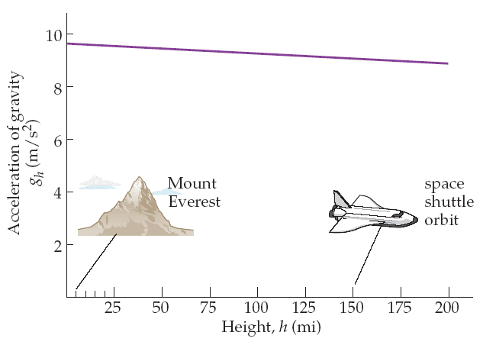
Gravitational Acceleration
The acceleration of gravity decreases slowly with altitude:

Slide 32
Q 2
A meteor is located ¾ of the way to the Moon on a line directly between the Earth and the Moon. What is its acceleration due to gravity?
Notes:
Ans: 4.27 x 10^-3 m/s/s towards Earth (need to consider acceleration effects from both the Earth and the Moon, then find the vector sum.

Slide 33
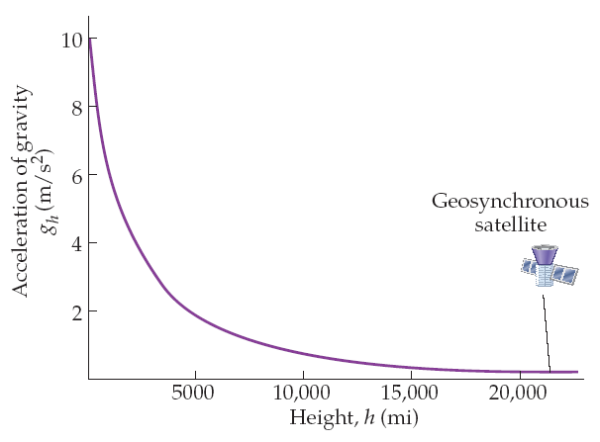
Gravitational Acceleration
Once the altitude becomes comparable to the radius of the Earth, the decrease in the acceleration of gravity is much larger:

Slide 34
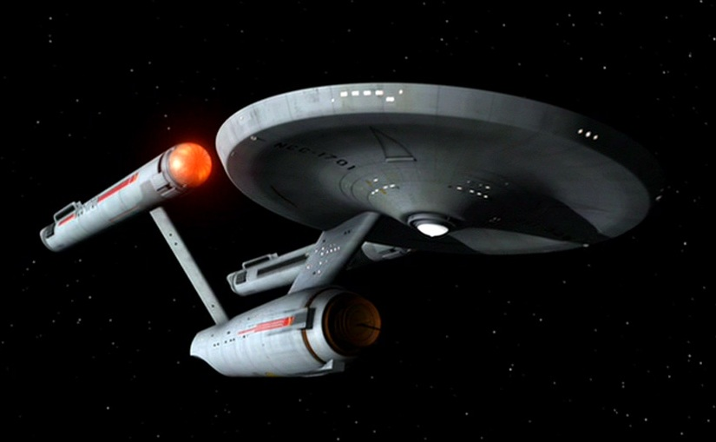
Sample Q 3
The Enterprise is located between a moon and its planet, which is 50x the mass of the moon. They are distance R apart. Captain Kirk’s instruments tell him that the gravitational pull of the planet is twice the gravitational pull of the moon. Find his location in terms of ‘R’.
Notes:
Ans: (5R/6) – closer to the moon than the planet (sqrt of both sides earlier than you think, no need to solve quadratically).

Slide 35
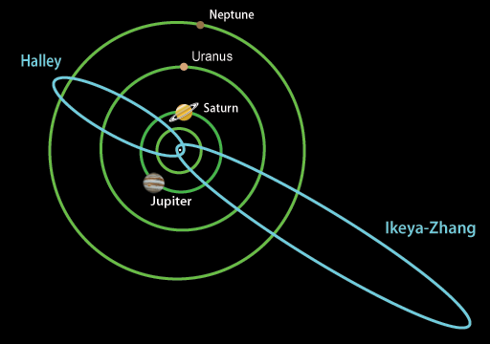
et
Orbital motion

Slide 36
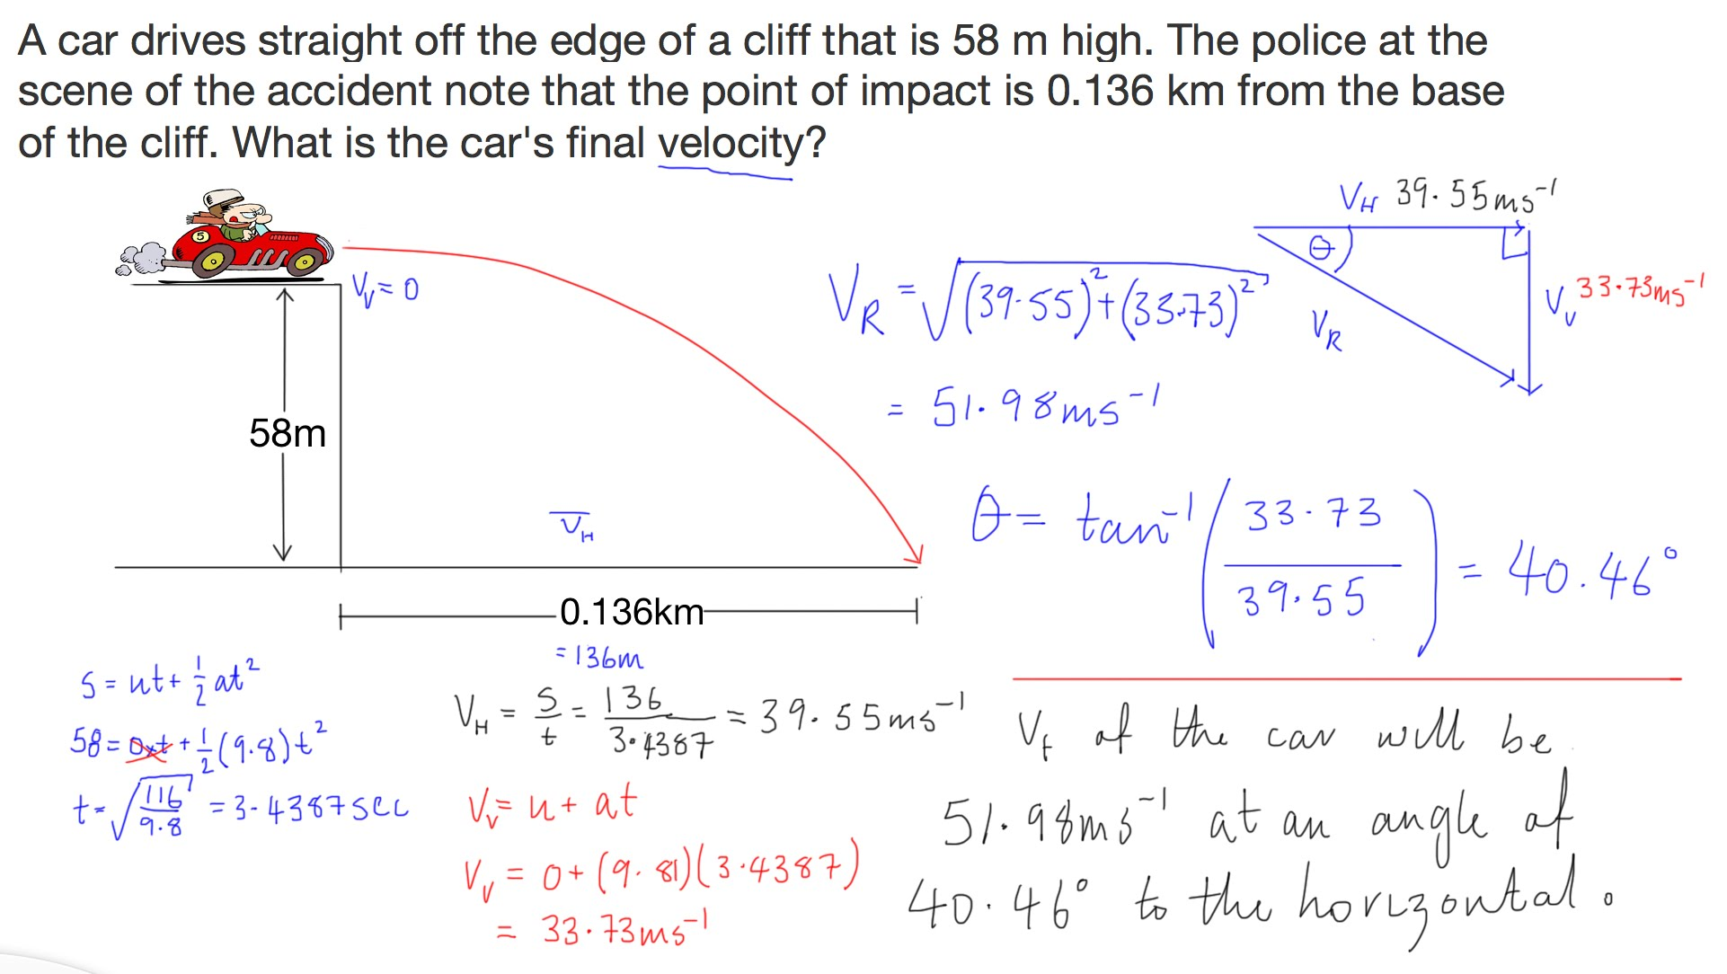
Free fall off a cliff – ‘old hat’ now

Slide 37
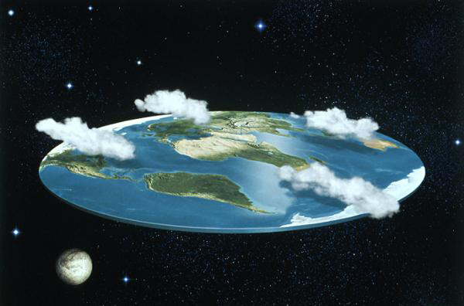
Flat Earth?

Slide 38
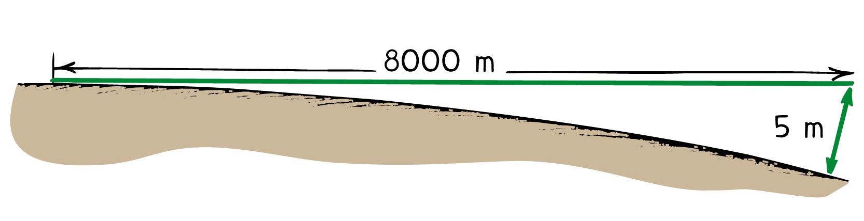
Earth curvature
In projectile motion, we assumed that the Earth was flat.
For large ranges, curvature of the earth enters calculations

Slide 39
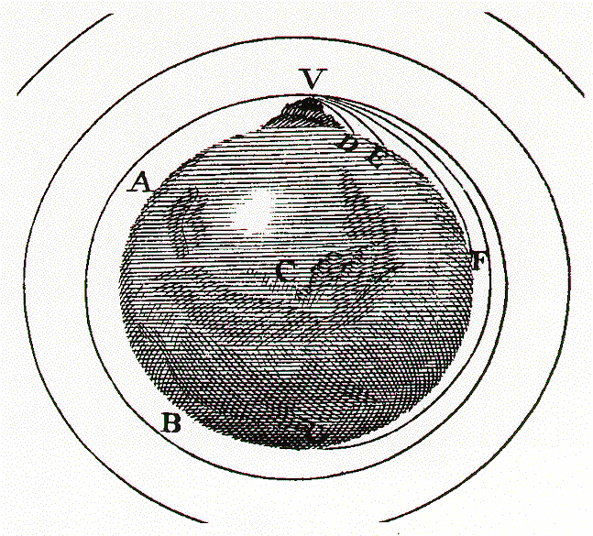
Newton’s Cannon

Slide 40
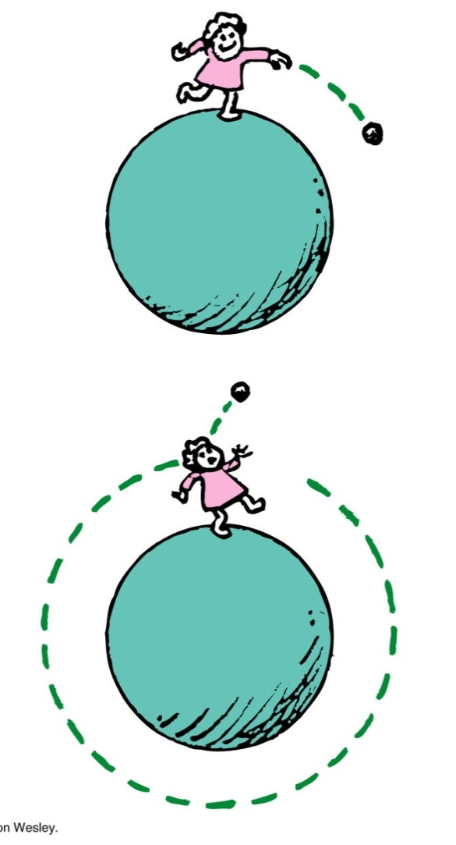
Satellites
Satellites thus are effectively always falling towards Earth, but the Earth curves away under them too quickly for impact.
This will happen at different speed for different altitudes

Slide 41
Orbital motion
Important concept:
Orbital motion can be considered as circular motion, with the centripetal force supplied by gravity

Slide 42
Thus

Slide 43
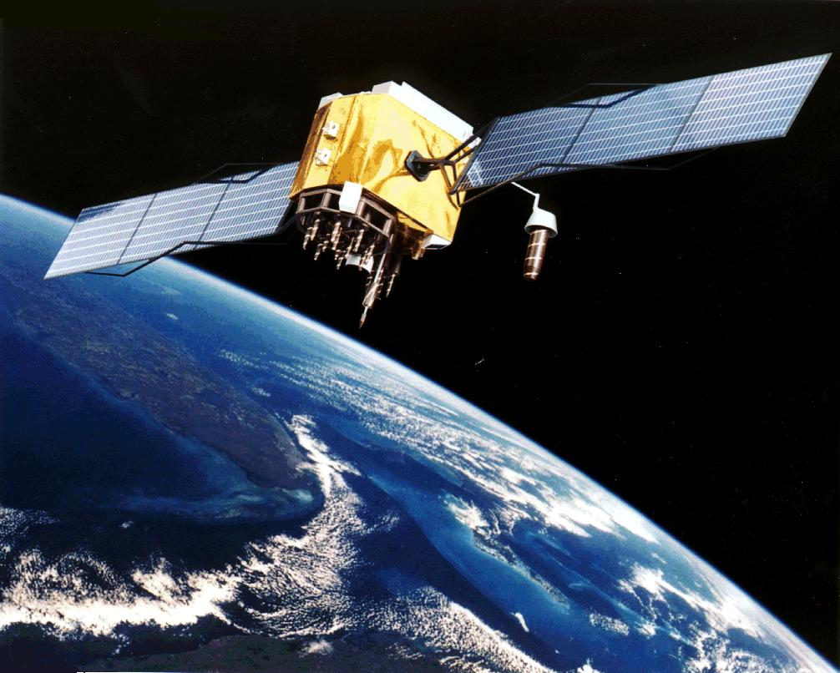
Sample Q 4
A weather satellite orbits the Earth at an altitude of 1000 km. Answer the following IN ORDER…
a) What is its orbital period, T?
b) What is its speed?

Slide 44
Sample Q 4
The most general way to approach this problem is first to derive Kepler’s Third Law of planetary motion (we consider only circular orbits)

Slide 45
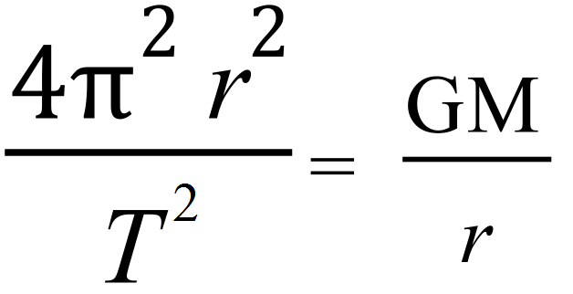
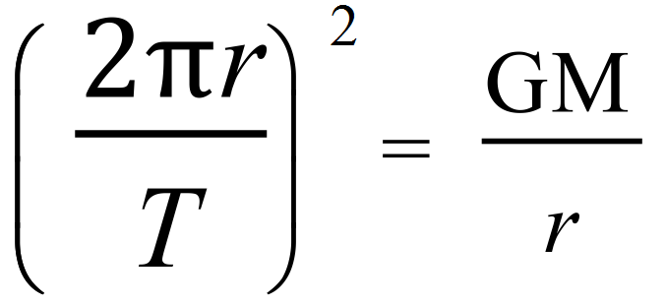
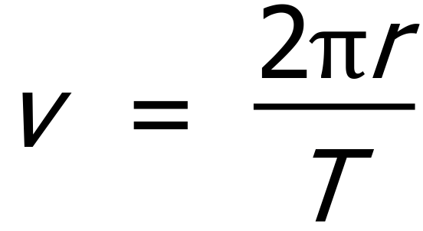
You do it!
Sub in equations:
Cancel (m’s and r’s):
But recall for circular motion:
Sub v into equation above
Bring the index into the brackets (carefully….!)

Slide 46

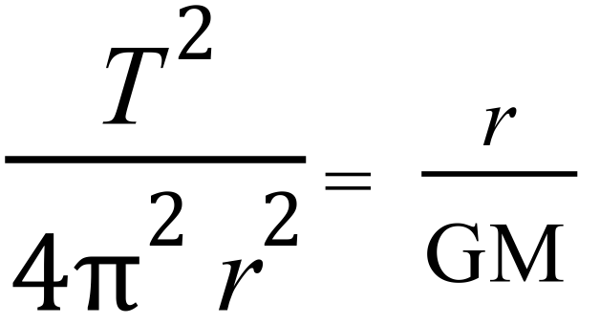
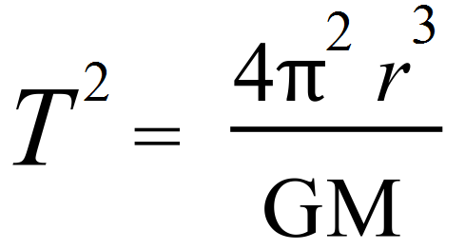
Nearly there….
Take reciprocals of both sides:
Isolate T²

Slide 47
This is Kepler’s 3rd Law of planetary motion
(in the form most useful for us)
Good news - this (now) appears on your formulae and data sheet! However, make sure you can derive it from F_{g} = F_{c}, as we just did.
Now return to the last sample question:

Slide 48
Back to Q 4
A weather satellite orbits the Earth at an altitude of 1000 km.
a) What is its orbital period, T, in hours?
b) What is its speed in km h⁻¹?
Ans: T = 1.75 h
v = 26500 km h⁻¹

Slide 49
Q 5: Calculate the orbital period of Neptune. Neptune is 4.50 billion km from the Sun.
**You will need your data sheets, and don’t forget that ‘r’ needs to be converted to metres…
Notes:
~165 years

Slide 50
Kepler’s law can be stated: For any orbit around a given body, the square of its’ period is proportional to the cube of its’ radius.
Or : T² ∝ r³

Slide 51
T² ∝ r³
Sample Q 6: In January this year, astrophysicists produced mathematical evidence for the long-suspected existence of another planet in the far outskirts of the Solar system, called simply ‘Planet 9’
They think it’s around 105 billion km from the Sun.
Using the result of your last calculation and the simple expression above, estimate the orbital period of ‘Planet 9’.
For Neptune T_{N}² ∝ r_{N}³
For Planet 9 T_{P}² ∝ r_{P}³

Slide 52
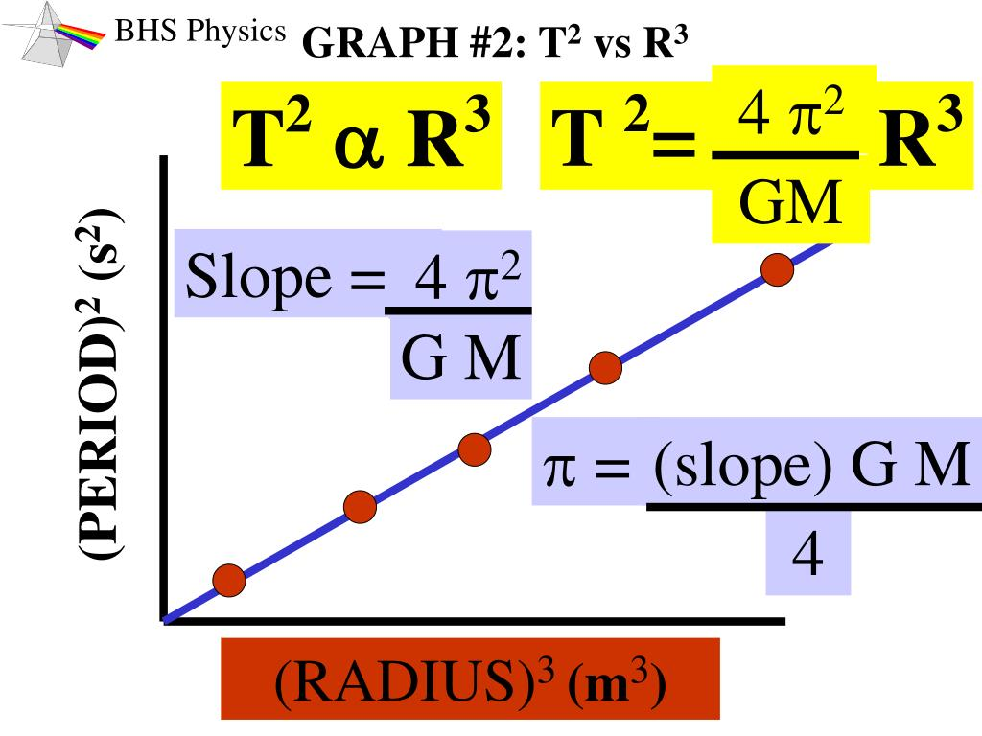
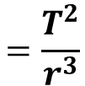
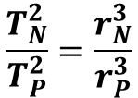
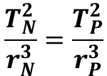
T² ∝ r³
Another way to think of this is to plot the relationship:
Gradient = Rise
Run
∴
(as gradient will be constant if the star/planet they orbit is the same).
Rearranging…
$$=\frac{T^{2}}{r^{3}}$$
$$\frac{T_{N}^{2}}{r_{N}^{3}}=\frac{T_{P}^{2}}{r_{P}^{3}}$$
$$\frac{T_{N}^{2}}{T_{P}^{2}}=\frac{r_{N}^{3}}{r_{P}^{3}}$$

Slide 53
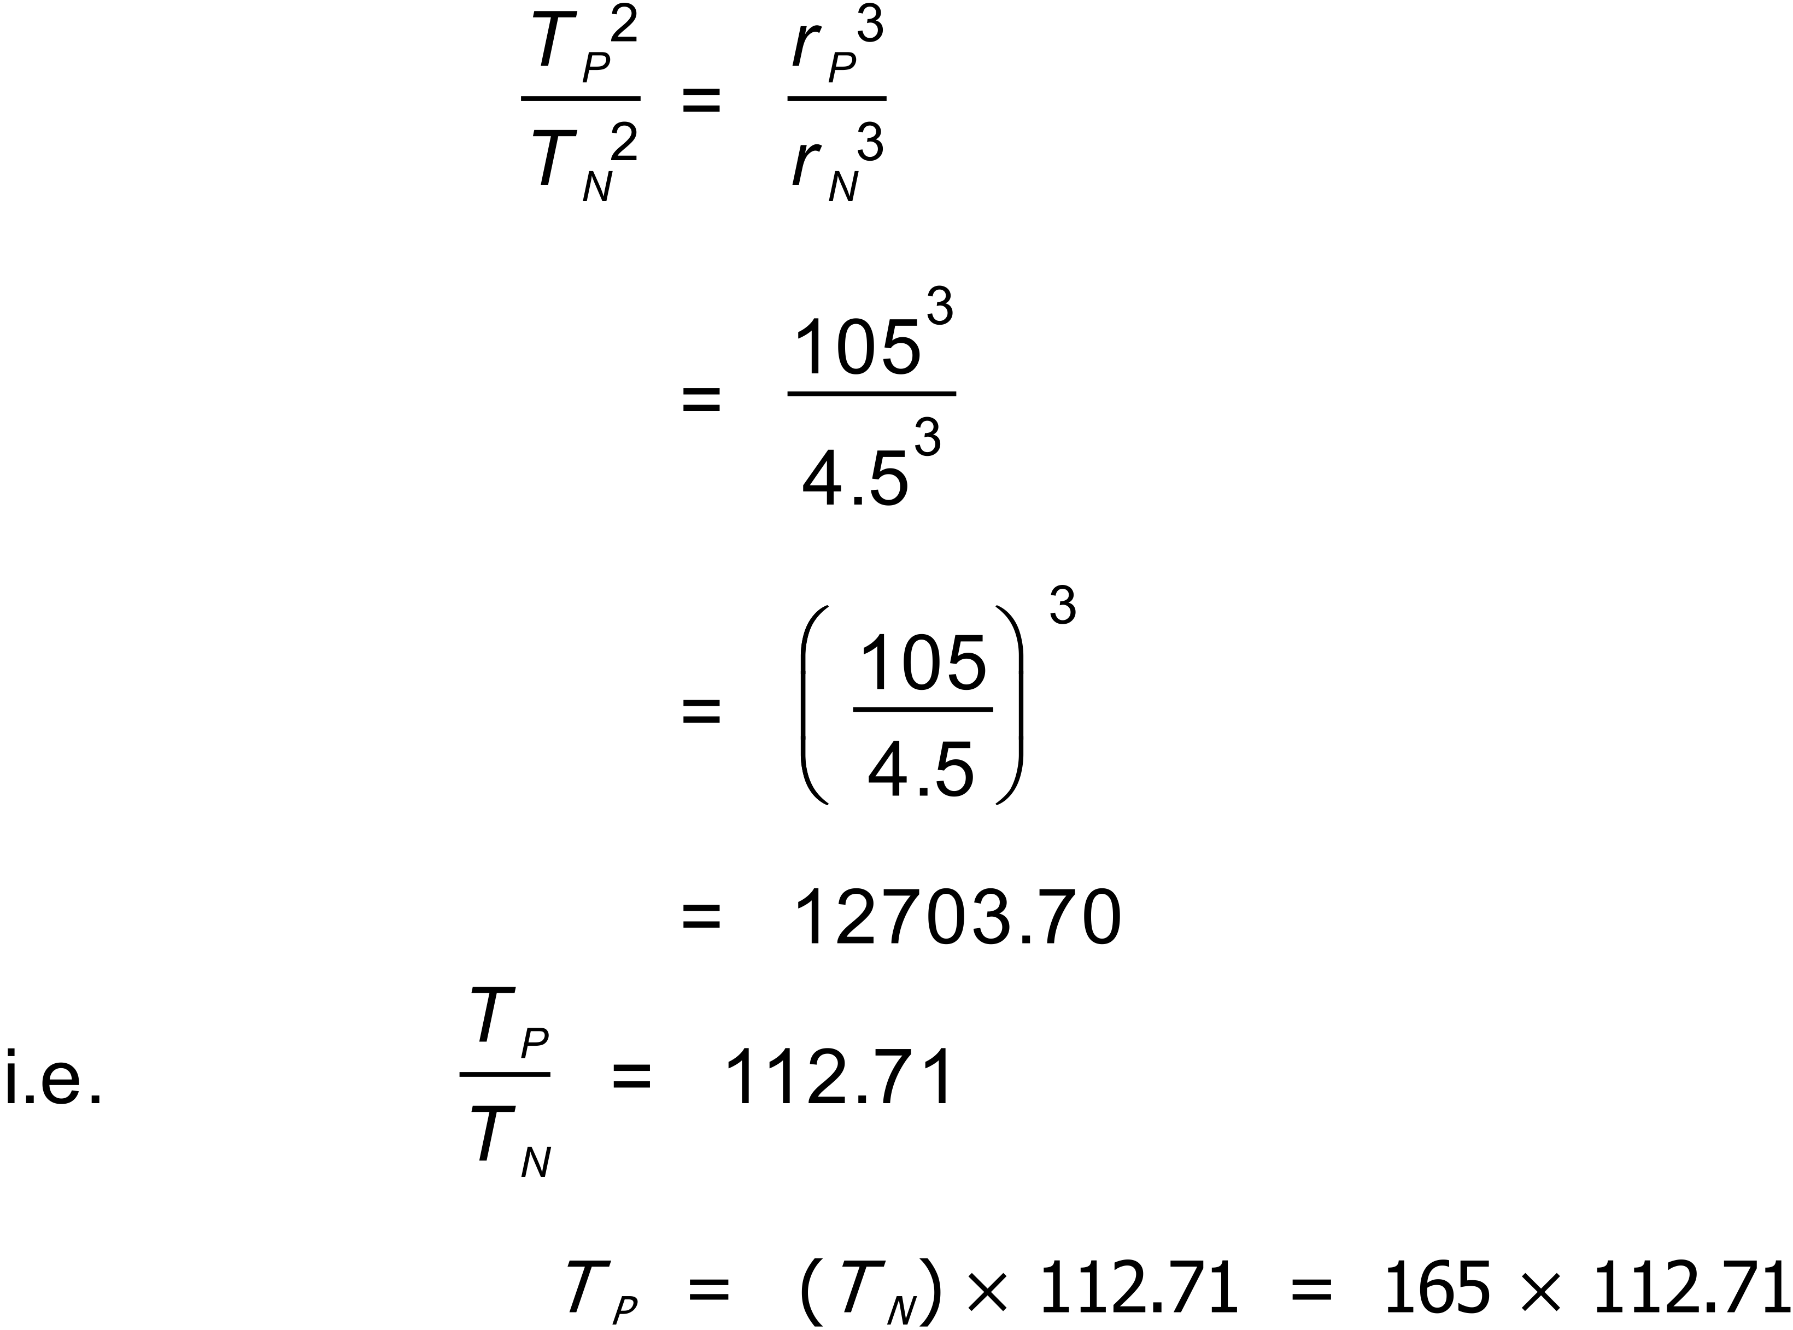
Simple arithmetic to find T_{P}
Thus:
I.e. orbital period of Planet 9 might be about 18 600 years!

Slide 54
Notice that the period of the orbit is only dependent on the ‘central mass’ (called the ‘primary’).
Measuring distances in astrophysics can be done various ways, but masses are much harder!
Kepler’s 3rd Law can be used (in reverse to our last examples) to calculate the mass of the primary if you can time and measure an orbit.
E.g. Pluto was discovered in 1930, but its mass was only determined 50 years later when its largest moon, Charon, was discovered.

Slide 55
Question 7
Charon’s period around Pluto was easily measured as 6.39 Earth days. The radius of its orbit was measured as approximately 19600 km. Calculate the mass of Pluto.
Notes:
Ans: 1.46 x 10^22 kg

Slide 56
Satellite orbit radius
Kepler’s law (T² ∝ r³ , or T ∝ r^{3/2} ) confirms that the larger the orbit, r, the longer the period, T.
Moon: T = 27.3 days
(V)LEO: T = 90 mins (!)

Slide 57
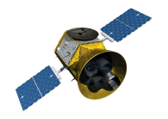
Scale diagram of Earth & moon
ISS 400 000 m (altitude)
T = 90 mins
Moon, 3.84 x 10⁸ m
T = 27 DAYS
Somewhere in between, must be a place where T = 24 hours!
Would this be a handy place to put an artificial satellite?
ANSWER: YES!!

Slide 58
Geosynchronous orbits
A geosynchronous satellite is one whose orbital period is equal to one day. If such a satellite is orbiting above the equator, it will be in a fixed position with respect to the ground.
This can be very useful!

Slide 59

Geostationary orbit

Slide 60
Geostationary orbits
These satellites are used for communications and and weather forecasting.
They are all at the same orbit radius .
Can we calculate this orbit?
EASY – we just let T = 24 hours (in seconds), M = M_{E} and calculate r! TRY IT NOW!
Notes:
r = 4.22 x 10^7 m. Altitude = Ans – Radius of Earth = 3.59 x 10^7 m (or 35900 km above Earth’s surface).

Slide 61
Calculating the altitude of geostationary orbit
Or, to find the altitude, you will subtract the Earth radius, which gives:
h = 3.59 × 10⁷ m

Slide 62
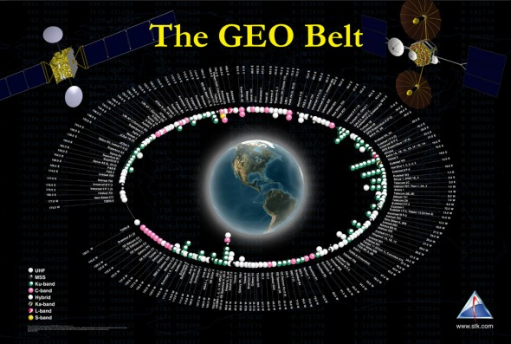

Slide 63
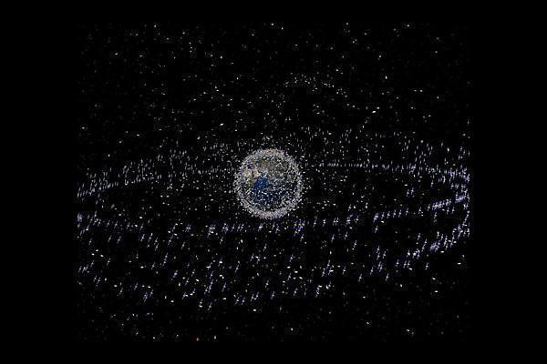

Slide 64
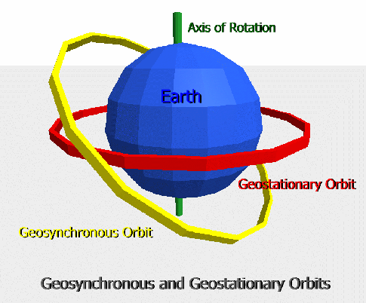
Geosynchronous vs geostationary orbits
Geosynchronous = any orbit with period 24 hours, Geostationary = above the equator

Slide 65
Different orbits
LEOs
Relatively cheap to get to LEO
good imaging! – Google Earth, weather, science applications
Some will pass over the same location on Earth many times a day (good and bad)
Safer for visiting - ISS and Hubble telescope
Many of these orbits are Polar Orbits

Slide 66
Different orbits
POLAR ORBITS
Can cover a lot of ground as the Earth moves around ‘underneath the orbit’
Good for mapping/imaging, spy satellites, some communications

Slide 67
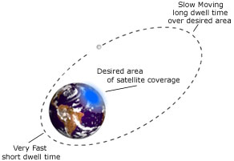
Different orbits
ECCENTRIC ORBITS
Not too important to us, but be aware they exist

Slide 68
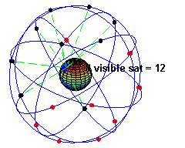
Different orbits
GPS
Medium Earth Orbit (MEO) - around 20000 km
Orbit period: 12 h
Many satellites make up the GPS network, as at any time at least 4 must be visible for 3-D triangulation

Slide 69
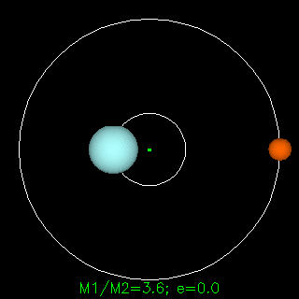
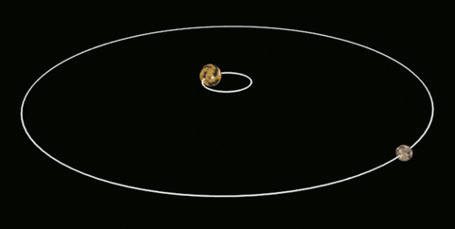
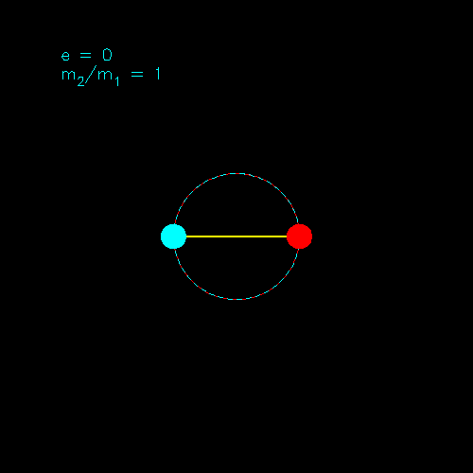
Force of Attraction Between Celestial Bodies
Technically, when we talk of moons orbiting planets or planets orbiting stars, the actual motion of both bodies is around the centre of mass for the system. This is usually inside the more massive body, but it doesn’t have to be. For example, consider the binary star system pictured bottom-right. The stars are of equal mass, so it is not a case of one orbiting the other – both orbit the centre of mass for the system.
We will only consider orbits around the centre of mass of the primary (only these are assessed in the course), but be aware that these other orbits exist.
*In these scenarios, it is possible for the system centre of mass to move.

Slide 70
Topic Summary So Far…
Force of gravity between two point masses:
G is the universal gravitational constant:
In calculating gravitational forces, spherically symmetric bodies can be replaced by point masses.

Slide 71
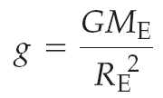
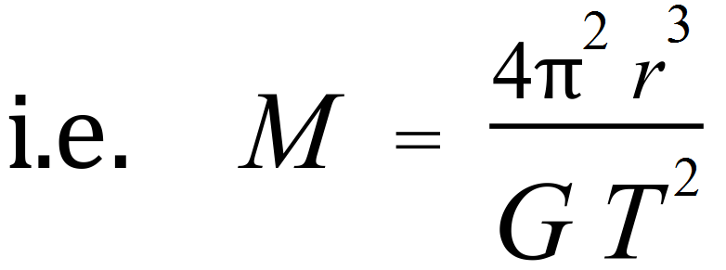
Summary 2
Acceleration of gravity:
Mass of any primary body:
Kepler’s 3rd law can be derived by equating F_{c} to F_{g}
Square of orbital period is proportional to cube of orbital radius

Slide 72
Summary 3
A geosynchronous/geostationary orbit is parallel with the equator and has period = 24 hours.
Polar orbits circle the Earth in a north-south direction
LEOs are closer, allowing easy launch and better imagery of the planet surface.

Slide 73
Work in a Gravitational Field
In order to lift an object in a gravitational field, energy must be given to that object.
The gain in (potential) energy is given by:
E = mgh
h

Slide 74
Work in a Gravitational Field
A force must be applied to the object in order to overcome (i.e. balance) the weight force, allowing the object to ascend with constant velocity (or we could apply a greater force and have it accelerate upwards, but we’ll stick with the minimum force required for now).
h

Slide 75
Work in a Gravitational Field
Since we are applying a force over a distance, we are doing Work on the object, against (or on) the gravitational field.
W = F . s , s = h
W = F . h
h
Since we need only apply a force that is equal in magnitude to the weight force:
F = mg

Slide 76
Work in a Gravitational Field
Therefore
W = F . h
&
F = mg
Substituting…
W = mgh
h
Of course, this is the same as the result that we normally get for gravitational potential energy, ergo doing work on an object = giving it energy.
Notes:
Also, a change in energy indicates work being done.

Slide 77
Work in a Gravitational Field
However, the reality is that this equation only holds for objects that are fairly close to the Earth, where the assumption that g = 9.8 m/s/s still holds.
We have already seen that this is not the case for greater distances from Earth.
Let’s find a better equation to use…

Slide 78
Work in a Gravitational Field
For this exercise, we are going to say that E_{P} = U (this is a Physics convention).
U = mgh , g = GM , h = r
r²
Therefore…
U = m(GM)r
r²
U = GMm
r
*Should technically be negative as point where U = 0 is an infinite distance away.

Slide 79
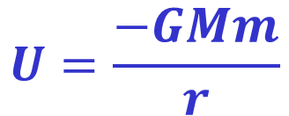
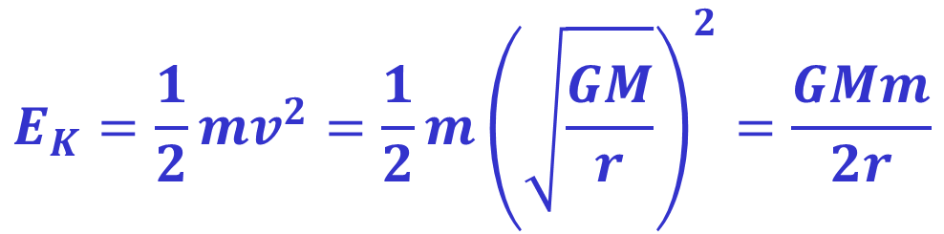


Work on Satellites
We know the following:
Substituting…
$$U=\frac{−GMm}{r}$$
$$v_{orbital}=\sqrt{\frac{GM}{r}}$$
$$E_{K}=\frac{1}{2}mv^{2}$$
$$E_{K}=\frac{1}{2}mv^{2}=\frac{1}{2}m{\left(\sqrt{\frac{GM}{r}}\right)}^{2}=\frac{GMm}{2r}$$

Slide 80



Work on Satellites
We can now use these equations to find the potential energy, kinetic energy & orbital speed for a satellite at any altitude (not in data sheet – know how to derive).
How do we find the Work required to go from a lower altitude to a higher one?
$$v_{orbital}=\sqrt{\frac{GM}{r}}$$
$$U=\frac{−GMm}{r}$$
$$E_{K}=\frac{GMm}{2r}$$

Slide 81


Work on Satellites
We start by finding an expression for the total energy at a given distance from the center of mass.
$$E_{Total}=E_{K}+E_{P}=E_{K}+U$$
$$E_{Total}=\frac{GMm}{2r}+\frac{−GMm}{r}$$
$$E_{Total}=\frac{−GMm}{2r}$$

Slide 82









Work on Satellites
R_{E}
R_{E}
R_{E}
Suppose we have a satellite that is a distance of 1 Earth Radius (R_{E}) above the surface of the Earth, wanting to move to a distance of 2R_{E} above. Find the work required to make the move:
$${∆E}_{Total}=E_{Final}−E_{Initial}$$
$${∆E}_{Total} =\frac{−GMm}{6R}−\frac{−GMm}{4R}$$
$${∆E}_{Total} =\frac{−GMm}{6R}+\frac{GMm}{4R}$$
$$E_{Total}\left(2R\right)=\frac{−GMm}{2\left(2R\right)}=\frac{−GMm}{4R}$$
$${∆E}_{Total} =\left(\frac{−1}{6}+\frac{1}{4}\right)\frac{GMm}{R}$$
$$E_{Total}\left(3R\right)=\frac{−GMm}{2\left(3R\right)}=\frac{−GMm}{6R}$$
$${∆E}_{Total} =\left(\frac{1}{12}\right)\frac{GMm}{R}$$

Slide 83







Work on Satellites
R₂
R₁
We can extrapolate this to a general formula for moving from any one height to any other:
$$E_{Total}\left(R_{1}\right)=\frac{−GMm}{2\left(R_{1}\right)}=\frac{−GMm}{2R_{1}}$$
$${∆E}_{Total} =\frac{−GMm}{2R_{2}}+\frac{GMm}{2R_{1}}$$
$$E_{Total}\left(R_{2}\right)=\frac{−GMm}{2\left(R_{2}\right)}=\frac{−GMm}{2R_{2}}$$
$${∆E}_{Total} =\left(\frac{−1}{R_{2}}+\frac{1}{R_{1}}\right)\frac{GMm}{2}$$
$${∆E}_{Total}=E_{Final}−E_{Initial}$$
$${∆E}_{Total} =\left(\frac{1}{R_{1}}−\frac{1}{R_{2}}\right)\frac{GMm}{2}$$
$${∆E}_{Total} =\frac{−GMm}{2R_{2}}−\frac{−GMm}{2R_{1}}$$
(i.e. work done to move satellite)

Slide 84



Work on Satellites
R₂
R₁
We can also derive general formulae for the changes in potential and kinetic energy:
$${∆E}_{Total} =W=\left(\frac{1}{R_{1}}−\frac{1}{R_{2}}\right)\frac{GMm}{2}$$
$$∆U =GMm\left(\frac{1}{R_{1}}−\frac{1}{R_{2}}\right)$$
$${∆E}_{Kinetic} =\left(\frac{1}{R_{2}}−\frac{1}{R_{1}}\right)\frac{GMm}{2}$$
(*will be negative if increasing in altitude)

Slide 85
Work on Satellites
R₂
R₁
So, for a satellite in orbit that is “ just chillin’ ” (not moving to a new orbit – just maintaining orbit), is it doing Work against the Gravitational field? Is the field doing work against it?
Answer: No. W = F . s, but the force and the displacement have to be pointing in the same direction (i.e. parallel). In circular motion, they are perpendicular (force directed towards center of planet, displacement directed at tangent to circle), so no work is done.
Technically, W = F . s . cos θ .

Slide 86

Work on Satellites
There is another way to find the work done on a satellite – graphically! (Graph from Pearson p.31)
Force vs. Distance graph:
Area under graph = x . y
Therefore:
Area = Force x Distance (F . s)
∴ Area = Work Done (J)

Slide 87

Work on Satellites
We can also use a Field Strength vs. Distance Graph (Graph from Pearson p.33)
Units for area under graph:
(N/kg).m
=N m/kg
*Notice that N m (Newton-meters) is a force times a distance (i.e. Work… energy)
=J/kg

Slide 88

Escape Velocity
One final thing – how fast do we need to move in order to escape the gravitational pull of a planet (ignoring friction)?
Think of it like this; sometimes, Physicists describe things like gravitational fields as ‘potential wells’. If you fell into a well, you would need energy in order to get out.

Slide 89


Escape Velocity
Recall that potential energy is negative. The point where potential energy goes to 0 is (theoretically) an infinite distance away.
$$U=\frac{−GMm}{r}$$

Slide 90

Escape Velocity
So, in order to get to that point, we need to gain kinetic energy such that it cancels our negative potential. This only happens when E_{K} = U.
$$E_{K}=\frac{GMm}{r}$$
$$U=\frac{−GMm}{r}$$

Slide 91




Escape Velocity
So, we can do a bit of mathe-magic!
∴
∴
∴
$$E_{K}=\frac{GMm}{r}$$
$$\frac{1}{2}mv^{2}=\frac{GMm}{r}$$
$$v^{2}=\frac{2GM}{r}$$
$$v_{escape}=\sqrt{\frac{2GM}{r}}$$

Slide 92





Escape Velocity
So, escape velocity for Earth is…
$$v_{escape}=\sqrt{\frac{2GM_{E}}{R_{E}}}$$
$$v_{escape}=\sqrt{\frac{2(6.67×{10}^{−11})(5.97×{10}^{24})}{(6.37×{10}^{6})}}$$
$v_{escape}=$ 1.12 x 10⁴ m/s
$$or$$
$v_{escape}=$ 4.03 x 10⁴ kmph

